Slide 1
PHP in depth 3
3870

Slide 2
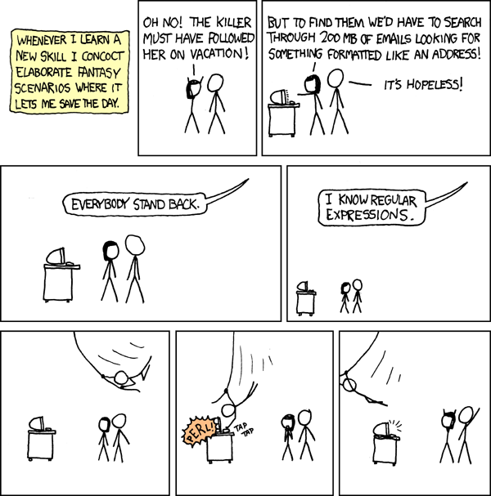

Slide 3
Review
//select statements
//try the following
SELECT now();
SELECT curdate();
SELECT curtime();
//to change password
mysqladmin –u root –p password
Notes:
http://dev.mysql.com/doc/refman/5.7/en/date-and-time-functions.html for more info

Slide 4
Create a blog database
//create a database called blog
CREATE DATABASE blog CHARACTER SET utf8;
//create table called entry
CREATE TABLE entry (
id int(11) NOT NULL AUTO_INCREMENT,
title varchar(255) NOT NULL,
description text NULL,
created datetime NOT NULL,
PRIMARY KEY (id)
);

Slide 5
Just playing
Let's first mess around with how to use MySQL functions in PHP with the newly created database

Slide 6
Create a simple form: input.html
<!DOCTYPE html>
<html>
<body>
<form action="process.php?mode=insert" method="POST">
<p>Subject: <input type="text" name="title"></p>
<p>Content: <textarea name="description" id="" cols="30" rows="10"></textarea></p>
<p><input type="submit" /></p>
</form>
</body>
</html>
Notes:
https://gist.github.com/tacksoo/4720cc197bcf45d1c519
Do you see the query string in the URL? Read all about it at: http://en.wikipedia.org/wiki/Query_string

Slide 7
Process entry: process.php
<?php
mysql_connect('localhost', 'root', 'password');
mysql_select_db('blog');
if( $_GET['mode'] === 'insert') {
$result = mysql_query("INSERT INTO entry (title, description, created) VALUES ('" .
mysql_real_escape_string($_POST['title']) . "', '" . mysql_real_escape_string($_POST['description']) . "', now())");
header("Location: list.php");
}
Notes:
https://gist.github.com/tacksoo/d92743805ed23460e4bf
mysql_real_escape_string() is a funny function
what is header()?

Slide 8
functions
mysql_query($query) – returns a resource which is not what we really want
mysql_fetch_array($result_from_query) – returns an array with all the rows

Slide 9
Exercise
Modify process.php so that it does not enter "empty" posts into the database
Hint: don't forget to use "break" after you use the header() function

Slide 10
List entries: list.php
// code is a bit too long to paste it here
https://gist.github.com/tacksoo/0a9d6179c0c3e396f63e
// list.php shows the titles on the left
// an entry is display is a query string is
// with an id is specified

Slide 11
Exercise
Add a "delete post" HTML button on list.php that deletes the currently displayed post

Slide 12
Modify entries: modify:php
<?php
mysql_connect('localhost', 'root', 'password');
mysql_select_db('blog');
$result = mysql_query('SELECT * FROM entry WHERE id = '.mysql_real_escape_string($_GET['id']));
$entry = mysql_fetch_array($result);
?>
<!DOCTYPE html>
<html>
<form action="./process.php?mode=modify" method="POST">
<input type="hidden" name="id" value="<?=$entry['id']?>" />
<p>Subject: <input type="text" name="title" value="<?=htmlspecialchars($entry['title'])?>"></p>
<p>Content: <textarea name="description" cols="30" rows="10"><?=htmlspecialchars($entry['description'])?></textarea></p>
<p><input type="submit" /></p>
</form>
</html>
Notes:
https://gist.github.com/tacksoo/4b8f968e5bd8cf7ba93c

Slide 13
htmlspecialchars()
//try this
echo htmlspecialchars('<a href="http://www.google.com/">Google</a>');
echo '<a href="http://www.google.com/">Google</a>';
//see the difference?

Slide 14
Exercise
Add some code in process.php to modify a blog post.
Hint:
// syntax to update a row
UPDATE entry SET title="some title", description="some description" WHERE id = X;
Notes:
gist.github.com/tacksoo/d92743805ed23460e4bf

Slide 15
Deprecated
Don't like mysql_real_escape_string() ?
MySQL 5.5 is deprecated as of PHP 5.5
We should all now use PDO or MySQLi

Slide 16
PHP types
Read more about it at:
http://www.php.net/manual/en/language.types.intro.php
Don't forget to var_dump() it if more information is required

Slide 17
Uniting testing in PHP
// First, add the following in composer.json
"require-dev": {
"phpunit/phpunit": "3.7.*"
},
// run the tests using the following command
vendor/bin/phpunit tests/

Slide 18
Exercise 1
Write a simple string function trim() that gets rid of leading and trailing whitespace

Slide 19
Exercise 2
Write a function that returns the n-th row of Pascal's tree for a given n. (The 0-th row is [1] )
Pascal's tree looks like the following:
1
1 1
1 2 1
1 3 3 1
1 4 6 4 1
and so on...

Slide 20

Question?
Do you need a HTML/CSS review?
Do you know div's, span's , page layout using HTML/CSS?

Slide 21
to be continued…

